Slide 1

Predicting Bike Sharing Demand
DATA 607 Project
Group Members:
Faraz Khan
Jannatul Naeema
Devanshi Patel
Utsav Argrawal
Deyvis Dalman

Slide 2

Introduction
Bike sharing programs are a growing industry, with over 500 bike-sharing programs globally.
Growth is motivated by both a move towards greener alternatives of transportation and cities becoming more bike friendly via the addition of bike lanes.
Insight into demand for bike sharing is valuable as it lets these businesses adjust around peak periods of demand to ensure their bike fleets are in optimized operations.
Pic courtesy: https://capitalbikeshare.com/

Slide 3
Dataset
The dataset was found on kaggle, it is featured in a competition for predict use of a city bikeshare system. The original dataset is also hosted at UCI machine learning repository.
The dataset was provided by the Capital Bikeshare program in Washington D.C
This dataset contains the hourly and daily count of rental bikes between years 2011 and 2012 with the corresponding weather and seasonal information. Hourly dataset is considered for this project.
It features ~17,000 entries and 12 columns: datetime, season, holiday, working day, weather, temp, avg temp, humidity, windspeed, casual, registered, count
Training data features the first 19 days of each month, while the test data has the remaining days. Test data does not have the count column.

Slide 4
Guiding Questions
Does weather conditions act as significant predictors for bicycle demand within a city?
How does the time of the day impacts bike rental demand?
Identify any weekly variation (weekends, holidays) and check if any of these are significant predictors.
Are there fluctuations in demand based on season?
Which techniques are the best for predicting bike rental demand throughout the year?

Slide 5
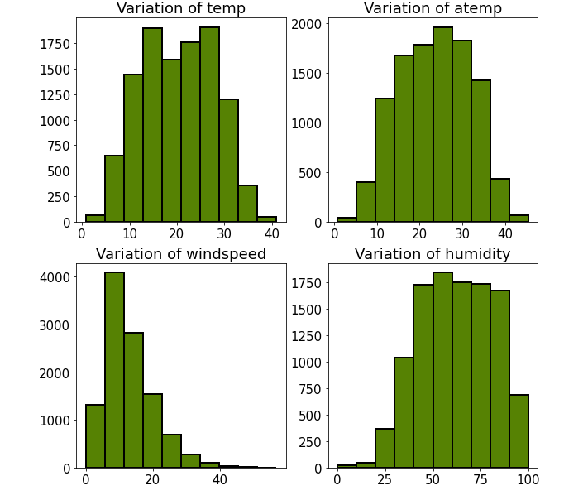
Data Cleaning and Wrangling
Checked for missing values
Dropped nonessential columns (Casual, registered)
Spliting date into year, month, day.
Log transformation applied for regression models.

Slide 6
Methodology
The team intends to run the following techniques on the dataset to test which is best at predicting bike ride share demand:
Linear regression
Lasso
RidgeCV
Random Forest
Bagging
Gradient Boosting
AdaBoost
SVR
KNN
XGBoost

Slide 7
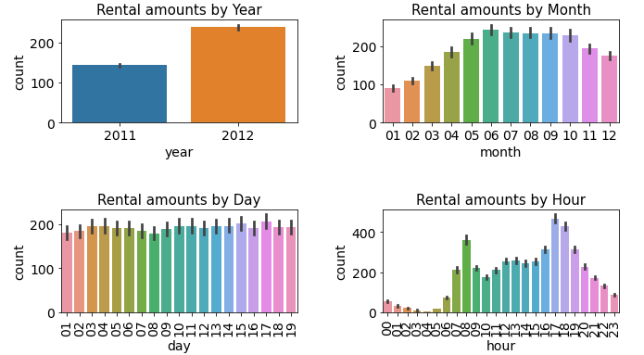
Exploratory Analysis
Rental peak hours are 8:00am and 5:00 pm – 7:00pm
Demand is constant throughout days 01-19 of the month
Demand for bike sharing is peak during May-October

Slide 8
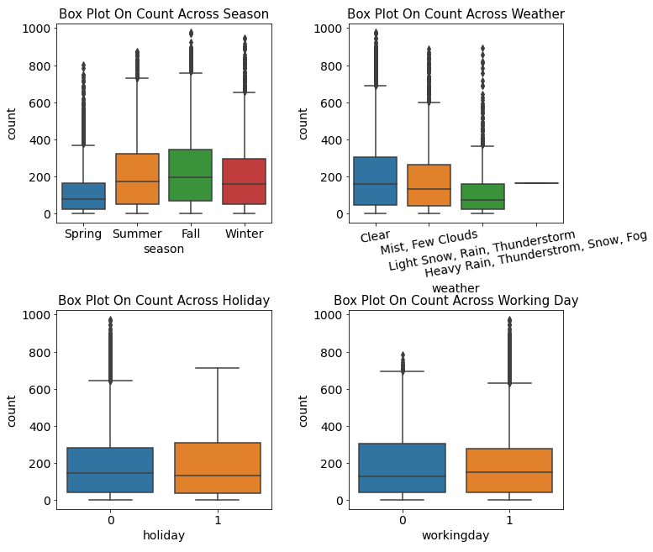
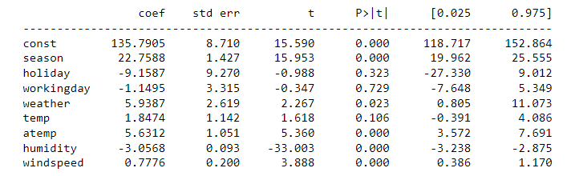








Exploratory Analysis Cont.
Better weather such as clear, leads to a greater amount of rentals
Holiday and non-holiday rentals are similar in composition
The season which has the highest rental count is fall, while spring is the lowest
Based on multiple linear regression significant predictors are holiday, workingday and temp.
Significance Results From Multiple Linear Regression

Slide 9
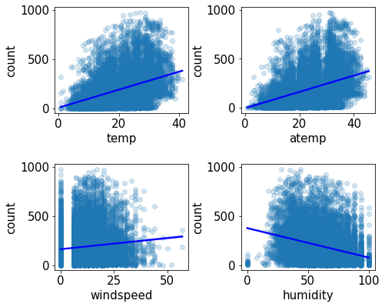
Exploratory Analysis Cont.
Scattered plot of rental quantity by temp, atemp, windspeed, humidity.
Analysis:
Higher the temperate and perceived temperature -> Higer the rental amount
Lower the humidity -> Higher the rent

Slide 10
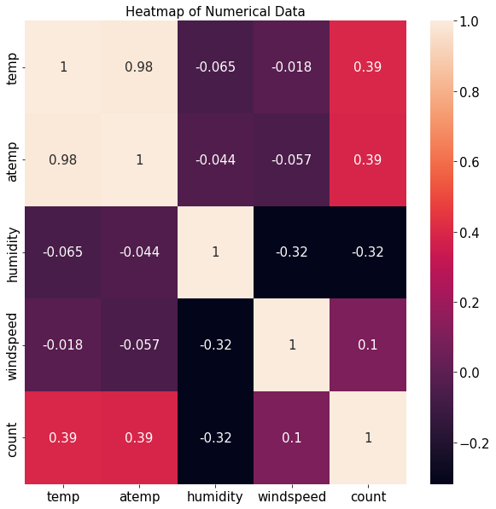
Exploratory Analysis Cont.
Plotted correlation matrix to find most significant predictor variable for rental quantity.
From the matrix it can be observed that temp, atemp are the more positively correlated than any other predictor variable while humidity is highly negative correlated.

Slide 11
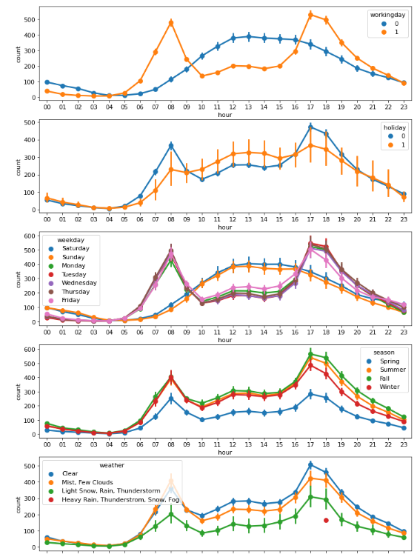
Exploratory Analysis Cont.
Constant
Rental patterns seem to be constant throughout the seasons sharing peak times and off-peak times
Rental demand peaks 7:00am-8:00am and 5:00pm-6:00pm on workdays
Weekend demand patterns differ greatly than weekdays, with steady demand from ~10:00am-~6:00pm

Slide 12
Exploratory Analysis Cont.
Peak
During Monday, Thursday and Friday peak hours for rental quantity are observed.
From 5:00pm – 7:00pm in any season people tend to use the bicycle more than any other timing, same pattern is observed for any weather condition.

Slide 13
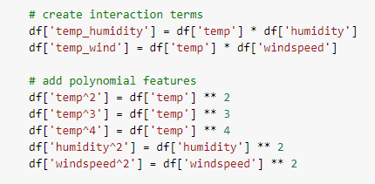
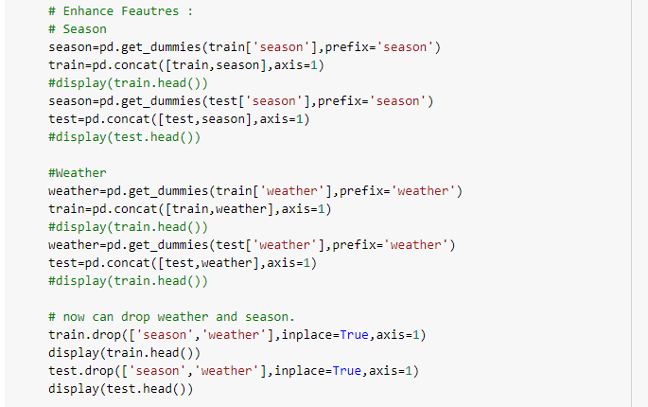
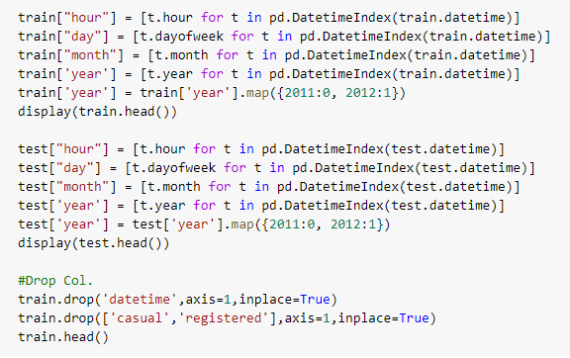
Creating Test and Training sets
Training and test sets were created for season, weather, hour, day, month and year.
Season and weather are turned into binary values and then dropped.
Created Interactive terms and polynomial features for regression models

Slide 14
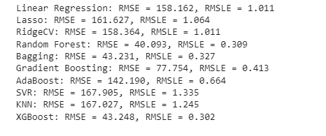
RMSE Analysis Models Tested
Model performance
Models tested:
Linear regression
Lasso
RidgeCV
Random Forest
Bagging
Gradient Boosting
AdaBoost
SVR
KNN
XGBoost

Slide 15
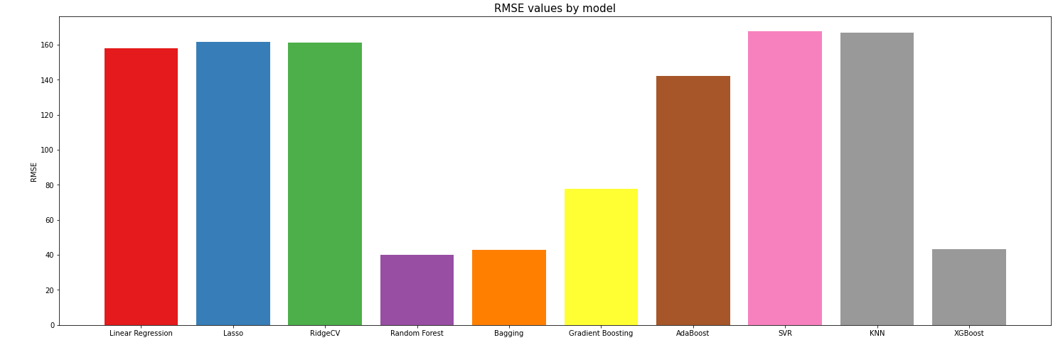
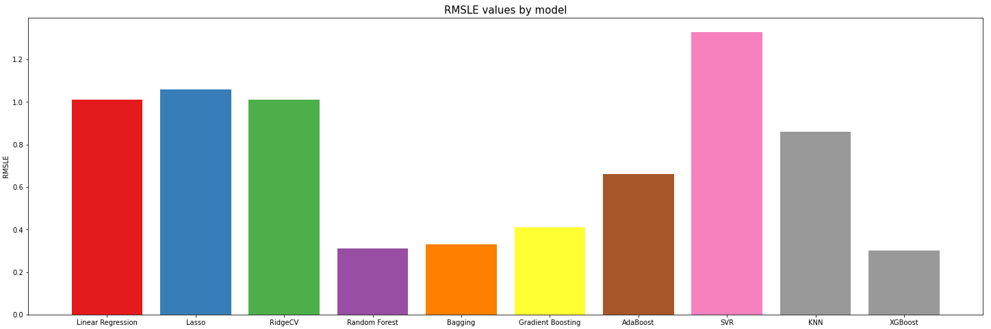
Visualization of Model performance
Random Forest has the lowest RMSE at 40.093 and XGBoost had the lowest RMSLE value at 0.302

Slide 16
Conclusion
Significant Predictors
Holiday
Demand Peak
Weekdays: 7:00-8:00am and 5:00-6:00pm (coincides with rush hour)
Rental Count
Lowest rental count in Spring
Highest in Fall
Working day
Temperature (only significant component of weather)
Weekend:10:00am-6:00pm
Best Model
Summer and Winter demands are close behind
XGBoost for the prediction of bike sharing demand

Slide 17
References
Bike Sharing Demand dataset. Retrieved from Kaggle at this link https://www.kaggle.com/c/bike-sharing-demand on 18th March 2023.
UCI machine learning repository Bike Sharing Dataset. Retrieved from http://archive.ics.uci.edu/ml/datasets/Bike+Sharing+Dataset on 18th March 2023.

Slide 18
Thank You

